Slide 1
External Sorting

Slide 2
Outline
In this topic we will look at external sorting:
Suppose we are sorting entries stored in secondary memory
What if we can’t load everything into main memory?
Can we sort sections of the unsorted data?

Slide 3
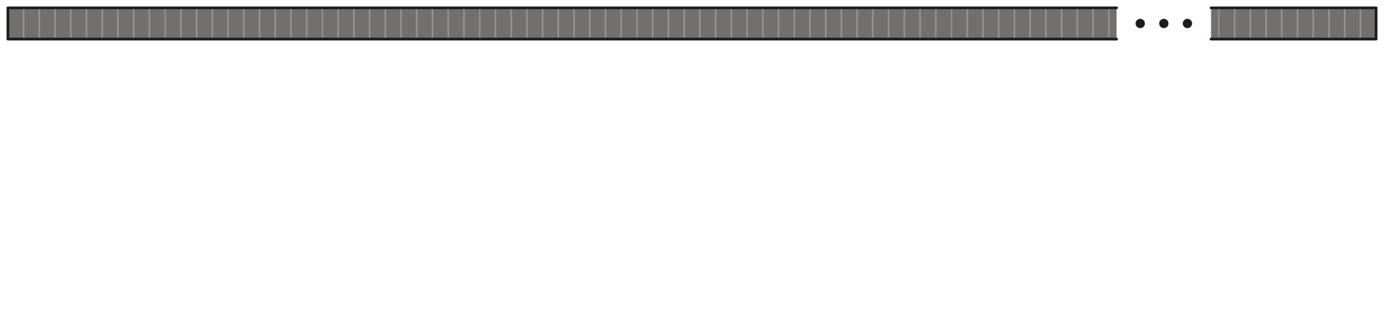
Situation
8.10
Suppose we are sorting n entries stored in secondary memory (a hard drive or tape drive) than cannot be loaded into main memory
These secondary storages are block addressable
Assume each block is 4 KiB and there are b entries per block
Note, 4 KiB blocks are a common division of both hard drives and of main memory pages

Slide 4
Naming Convention
8.10.1
Convention:
Lower-case variables will sort the number of entries being sorted
Entries being sorted, entries per block, etc.
Upper-case variables will store the size of larger structures

Slide 5
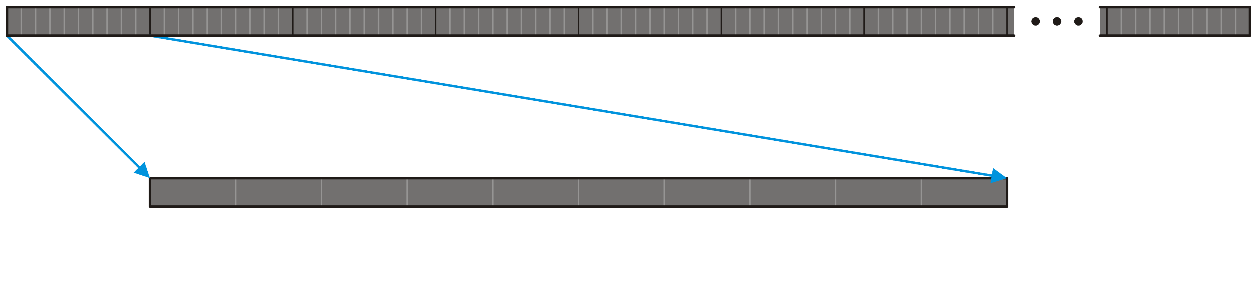
Strategy
8.10.2
First, assume we can load M blocks at a time into main memory
Divide the data we are sorting into N sections of M blocks
Each section has m = Mb entries and n = NMb
Here, we are loading the first M = 10 blocks into main memory

Slide 6
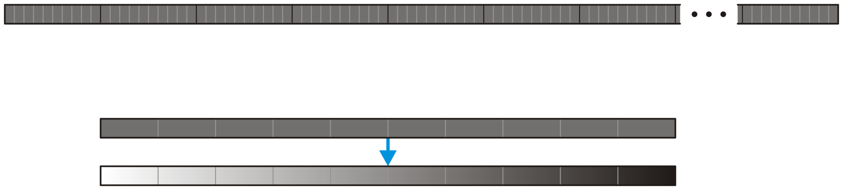
Strategy
8.10.2
On these m = Mb entries, apply an in-place sorting algorithm such as quicksort or merge sort
The run time is Θ( m ln(m) )

Slide 7
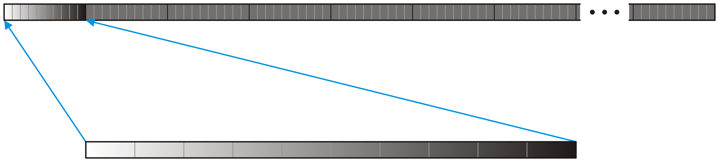
Strategy
8.10.2
Write these M sorted blocks back into secondary memory

Slide 8
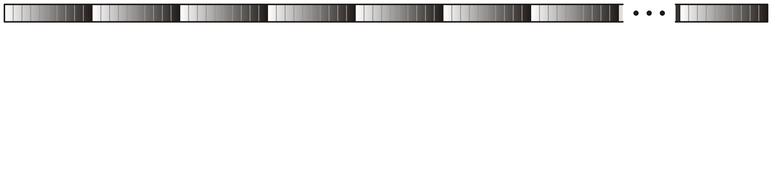
Strategy
8.10.2
Repeat this process for all N blocks
The run time is Θ( Nm ln(m) ) = Θ( n ln(m) )

Slide 9
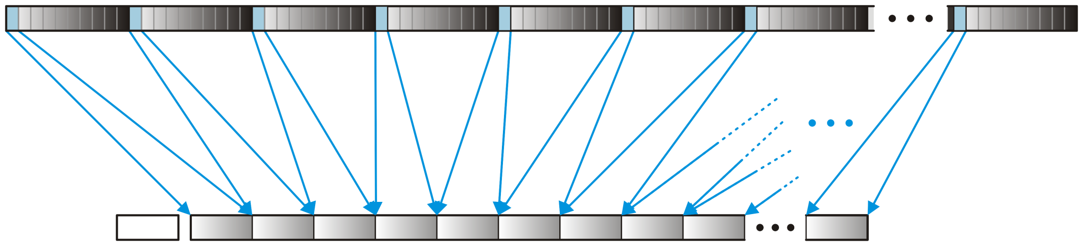
Strategy
8.10.2
Next, load the first block of each of the N sections into corresponding input buffers allocated in main memory
If we had 2 GiB of main memory, we could load 512 such input buffers
We would need to sort more than 1 EiB before this was not possible
The math:

Slide 10
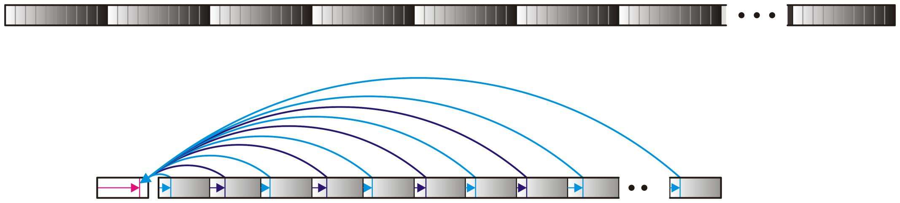
Strategy
8.10.2
Now, perform an N-way merge of these N sorted blocks into a single block-sized output buffer

Slide 11
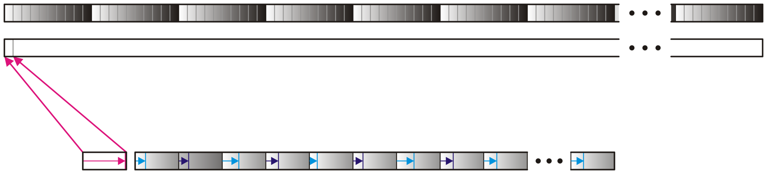
Strategy
8.10.2
When this output buffer is full, we will write it into secondary memory and start again with an empty buffer
Because we are using merging, we cannot do this in-place on secondary memory—we will require Θ(n) additional secondary memory

Slide 12
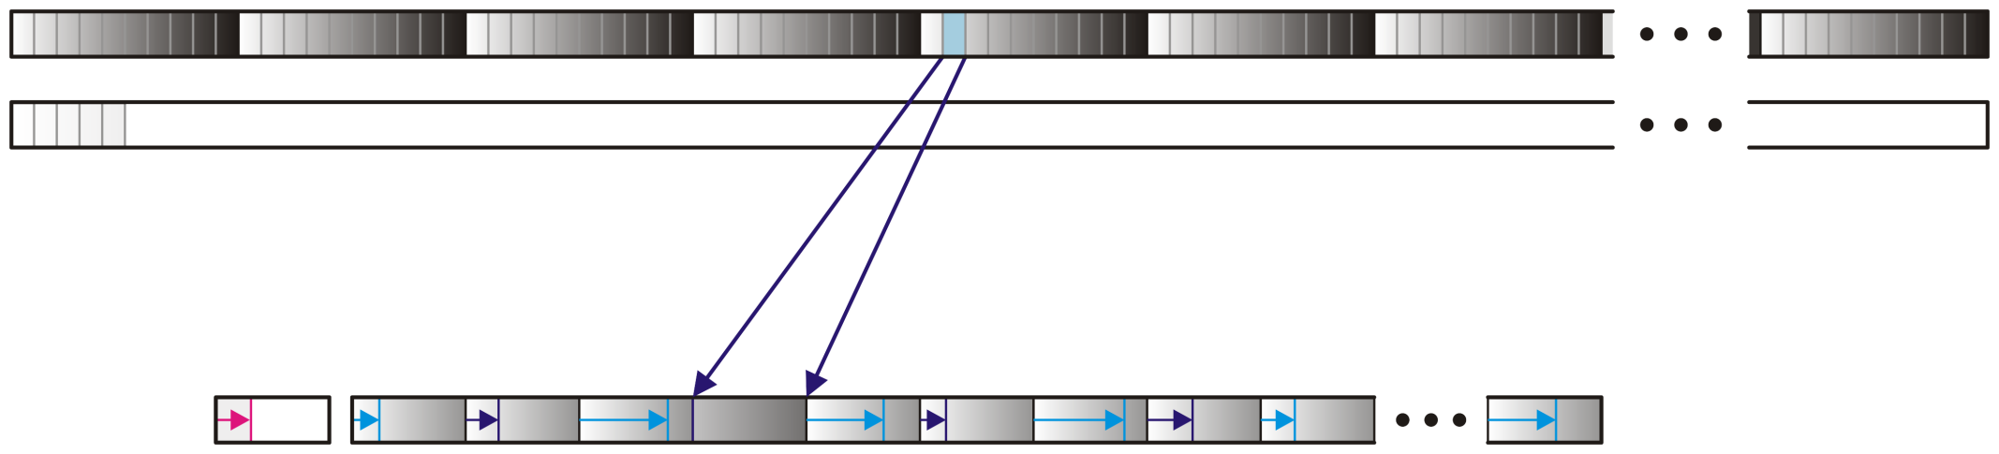
Strategy
8.10.2
Whenever one of the N input buffers is entirely merged, we load the next block from the corresponding section into the input buffer

Slide 13
Strategy
8.10.2
We continue this process of storing the merged block into secondary memory and reading subsequent blocks into main memory

Slide 14
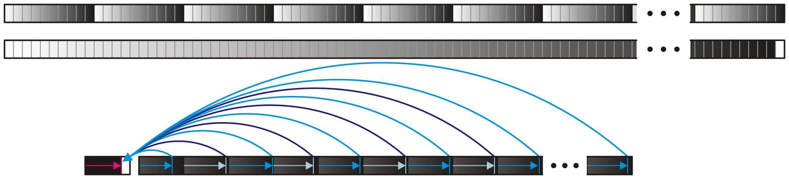
Strategy
8.10.2
We continue this process of storing the merged block into secondary memory and reading subsequent blocks into main memory
At some point we will be merging the last blocks of each of the sections

Slide 15
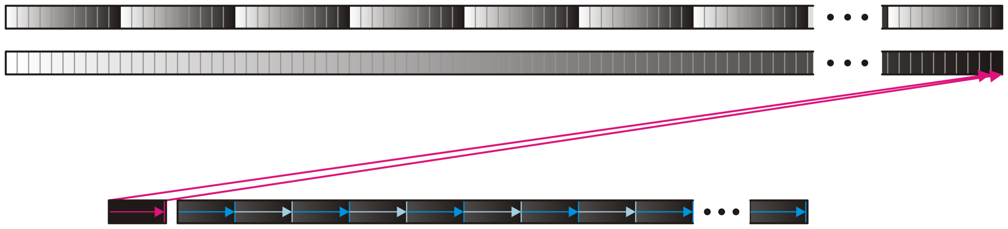
Strategy
8.10.2
When the last block is written out, the collection of MN blocks now contain a sorted list of the initial n entries

Slide 16
Run-time Analysis
8.10.3
With merge sort, we saw that merging was an Θ(n₁ + n₂) operation when merging lists of size n₁ and n₂
From slide 8, this suggests the run time is Θ( n ln(m) )
If m is sufficiently small, this suggests the run-time is Θ(n) !!!

Slide 17
Run-time Analysis
8.10.3
This, however, is a mathematical fallacy…
A binary merge can be performed in linear time, an N-way merge cannot
The best we can hope for is using a binary min-heap
Each will require O(ln(N)) time for a total of Θ( n ln(N) )
Thus, the total run time is Θ( n ln(m) + n ln(N) ) = Θ( n ln(mN) ) = Θ( n ln(n) )
Recall that n = mN

Slide 18
Run-time Analysis
8.10.3
To be complete, we should also consider the run time associated with loading and saving data to the disk:
Each item of data is copied from or to the external disk four times
We will assume the memory size of each item is fixed and reasonable
Thus, the run time of these operations is Θ(n)
If we are considering the size of the objects to be variable, say k bytes, we would have to revise our run time to Θ( n ln(n) + nk )

Slide 19
Additional Remarks
8.10.4
With 4 KiB blocks and 2 GiB of available main memory, we determined we could sort up to 1 EiB of data
What if our available memory was smaller, say 1 MiB?
Solution?
Divide the data into 256 MiB blocks
Sort each of these individually use external sorting
Now merge these using the same strategy
We are restricted by the number of blocks we can merge
This process can be repeated arbitrarily often—doing so K times allows us to sort

Slide 20
Additional Remarks
8.10.4
We have focused on one implementation of using block-sized buffers—optimizations, however, are always possible:
Performing the initial sorting (quick sort) in parallel
Storing at least a portion of the data in solid-state drives
Using larger input and output buffers (useful if the data is contiguous on the hard drive)

Slide 21
Summary
This topic covered external sorting
Divide the n entries being sorted into N sections that fit in main memory
Sort each of the N section and write to secondary memory
Load blocks from each section as necessary into main memory
Merge the sections using an N-way merge
Write the merged blocks to secondary memory
The run time is Θ(n ln(n))

Slide 22
References
Donald E. Knuth, The Art of Computer Programming, Volume 3: Sorting and Searching, 2nd Ed., Addison Wesley, 1998, §5.4, pp.248-379.
Wikipedia, https://en.wikipedia.org/wiki/External_sorting
Special thanks to Prof. Ran Ginosar who made some observations and suggestions and who led me to finding an error in my calculations
These slides are provided for the ECE 250 Algorithms and Data Structures course. The material in it reflects Douglas W. Harder’s best judgment in light of the information available to him at the time of preparation. Any reliance on these course slides by any party for any other purpose are the responsibility of such parties. Douglas W. Harder accepts no responsibility for damages, if any, suffered by any party as a result of decisions made or actions based on these course slides for any other purpose than that for which it was intended.

